Slide 1
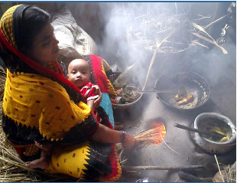
Operations Research to Support Social Innovation
Identify and understand barriers to access and adoption of proven WASH & IAQ technologies (e.g. market failures and behavioral barriers)
Design and test sustainable, scaleable business models and behavioral interventions (e.g. purchase contracts, seller incentives, social marketing)
Understand causal mechanism and quantify the health impacts of technology and social innovations in the “real world”
Notes:
Identify and measure specific pathogens – hands, soil, water

Slide 2
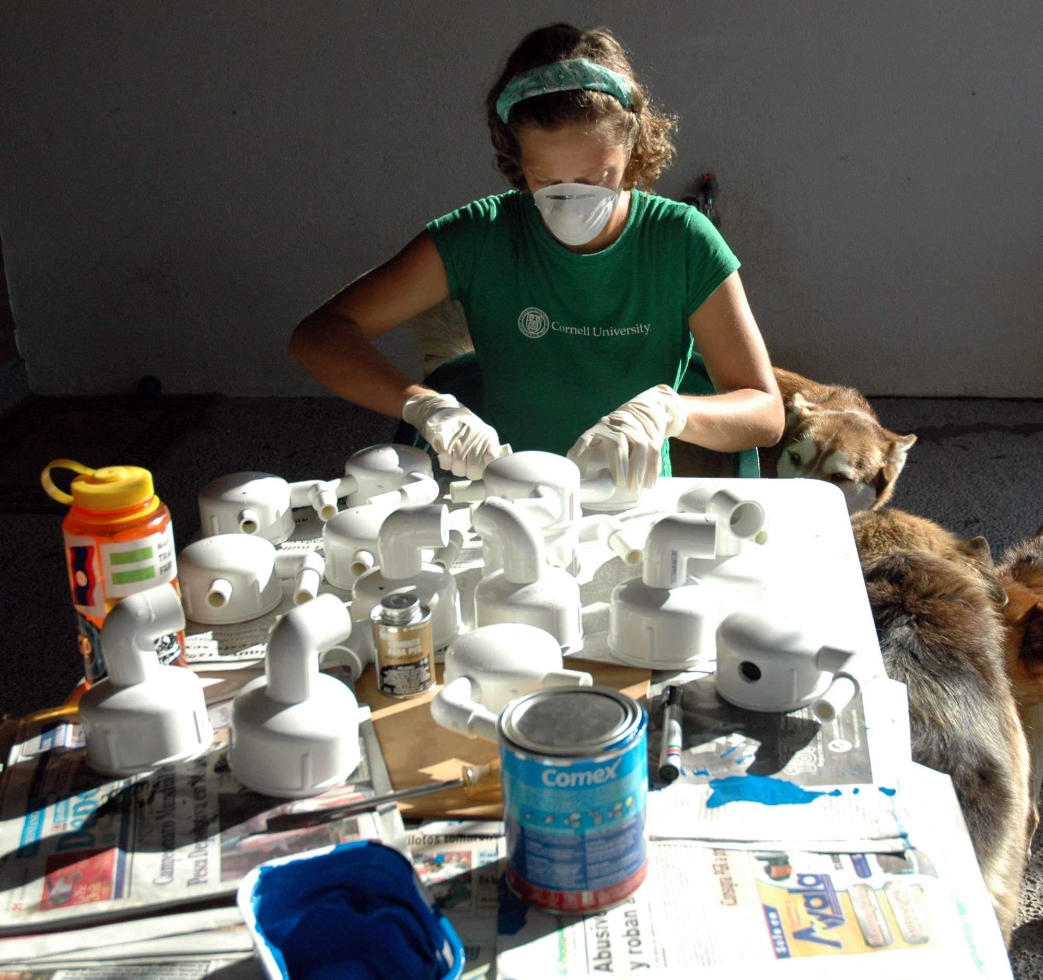
Engineering Innovative Solutions
Iterative, user-centric design of household and community safe water, sanitation and cook stove devices
Rapid prototyping, rigorous lab and field testing (in partnership with the Lawrence Berkeley National Lab and a wide network of international field sites and collaborators)
Supporting Learning Communities
Coordination of multi-country research programs that generate and share generalized knowledge
Credible, independent, ethical research partner committed to local capacity building and connected to global science & policy networks

Slide 3
Opportunities
India
Bangladesh
Uganda
Kenya
Guatemala
Why these countries?
Existing UCB activities, contacts, partnerships, credibility
Opportunities to scale
Notes:
India: Kirk Smith, Kara Nelson
Bangladesh: David Levine
Uganda: David Levine
Kenya; David Levine, Ted Miguel
Guatemala: Kirk Smith
Kenya/Uganda/Tanzania as a unified market opportunity

